Slide 1
dbms

Slide 2
Relationship Sets
The primary key of an entity set allows us to distinguish among the various entities of the set.We need a similar mechanism to distinguish among the various relationships of a relationship set.
Let R be a relationship set involving entity sets E1, E2, . . .,En. Let primary-key(Ei) denote the set of attributes that forms the primary key for entity set Ei. Assume for now that the attribute names of all primary keys are unique, and each entity set participates only once in the relationship. The composition of the primary key for a relationship set depends on the set of attributes associated with the relationship set R.

Slide 3
If the relationship set R has no attributes associated with it, then the set of attributes
primary-key(E1) ∪ primary-key(E2) ∪ · · · ∪ primary-key(En)
describes an individual relationship in set R.
If the relationship set R has attributes a1, a2, · · · , am associated with it, then the set
of attributes
primary-key(E1) ∪ primary-key(E2) ∪ · · · ∪ primary-key(En) ∪ {a1, a2, . . . , am} describes an individual relationship in set R.
In both of the above cases, the set of attributes
primary-key(E1) ∪ primary-key(E2) ∪ · · · ∪ primary-key(En) forms a superkey for the relationship set.
In case the attribute names of primary keys are not unique across entity sets, the attributes are renamed to distinguish them; the name of the entity set combined with the name of the attribute would form a unique name.

Slide 4
Design Issues
Use of Entity Sets versus Attributes
Consider the entity set employee with attributes employee-name and telephone-number. It can easily be argued that a telephone is an entity in its own right with attributes telephone-number and location (the office where the telephone is located). If we take this point of view, we must redefine the employee entity set as:
• The employee entity set with attribute employee-name
• The telephone entity set with attributes telephone-number and location
• The relationship set emp-telephone, which denotes the association between employees and the telephones that they have
Two natural questions thus arise: What constitutes an attribute, and what constitutes an entity set? Unfortunately, there are no simple answers. The distinctions mainly depend on the structure of the real-world enterprise being modeled, and on the semantics associated with the attribute in question.

Slide 6
Use of Entity Sets versus Relationship Sets
It is not always clear whether an object is best expressed by an entity set or a relationship set. we assumed that a bank loan is modeled as an entity. An alternative is to model a loan not as an entity, but rather as a relationship between customers and branches, with loan-number and amount as descriptive attributes. Each loan is represented by a relationship between a customer and a branch. If every loan is held by exactly one customer and is associated with exactly one branch, we may find satisfactory the design where a loan is represented as a relationship. However, with this design, we cannot represent conveniently a situation in which several customers hold a loan jointly. To handle such a situation, we must define a separate relationship for each holder of the joint loan. Then, we must replicate the values for the descriptive attributes loan-number and amount in each such relationship. Each such relationship must, of course, have the same value for the descriptive attributes loan-number and amount.
Two problems arise as a result of the replication: (1) the data are stored multiple times, wasting storage space, and (2) updates potentially leave the data in an inconsistent state, where the values differ in two relationships for attributes that are supposed to have the same value.

Slide 7
Binary versus n-ary Relationship Sets
It is always preferable to make a binary relation to have simplicity in the database. However in some cases we are bound to make it ternary or more.

Slide 8
Placement of Relationship Attributes

Slide 9
The cardinality ratio of a relationship can affect the placement of relationship attributes. Thus, attributes of one-to-one or one-to-many relationship sets can be associated with one of the participating entity sets, rather than with the relationship set.
For instance, let us specify that depositor is a one-to-many relationship set such that one customer may have several accounts, but each account is held by only one customer. In this case, the attribute access-date ,which specifies when the customer last accessed that account, could be associated with the account entity set.
As one customer may have more than one account so it is better to keep it with the account entity

Slide 10
Attribute of relationship
The choice of attribute placement is more clear-cut for many-to-many relationship sets. Returning to our example, let us specify the perhaps more realistic case that depositor is a many-to-many relationship set expressing that a customer may have one or more accounts, and that an account can be held by one or more customers. If we are to express the date on which a specific customer last accessed a specific account, access-date must be an attribute of the depositor relationship set, rather than either one of the participating entities.

Slide 12
ER MODEL
ENTITY TYPE
Entity types that do not have key attributes of their own are called weak entity types. In contrast, regular entity types that do have a key attributeare called strong entity types. Weak Entities belonging to a weak entity type are identified by being related to specific entities from another entity type in combination with one of their attribute values. We call this other entity type the identifying or owner entity type, and we call the relationship type that relates a weak entity type to its owner the identifying relationship of the weak entity type. A weak entity type always has a total participation constraint (existence dependency) with respect to its identifying relationship because a weak entity cannot be identified without an owner entity.
A weak entity type normally has a partial key, which is the attribute that can uniquely identify weak entities that are related to the same owner entity (in our example name is partial key)
In the worst case, a composite attribute of all the weak entity’s attributes will be the partial key.

Slide 16
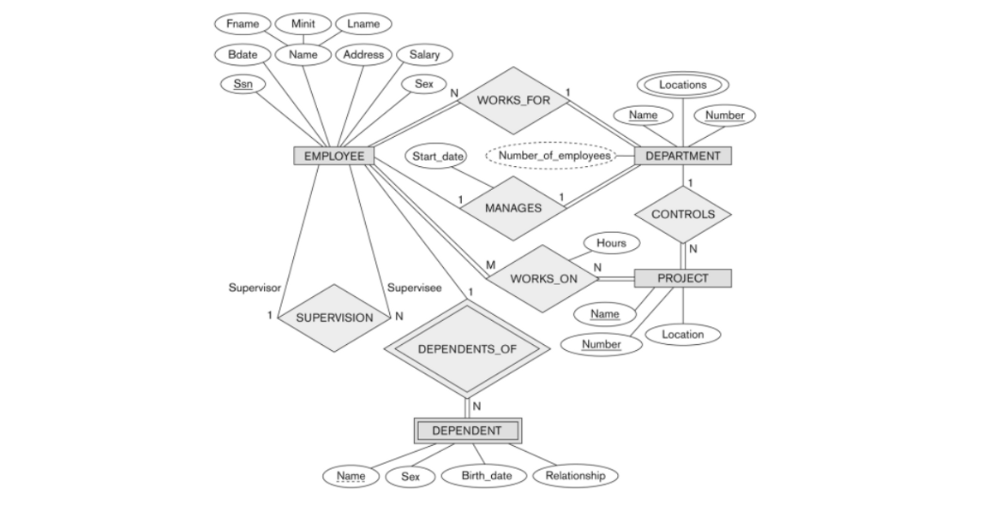

Slide 17
In our example, we specify the following relationship types:
■ MANAGES, a 1:1 relationship type between EMPLOYEE and DEPARTMENT. EMPLOYEE participation is partial. DEPARTMENT participation is not clear from the requirements. We question the users, who say that a department must have a manager at all times, which implies total participation. The attribute Start_date is assigned to this relationship type.
■ WORKS_FOR, a 1:N relationship type between DEPARTMENT and EMPLOYEE. Both participations are total.
■ CONTROLS, a 1:N relationship type between DEPARTMENT and PROJECT. The participation of PROJECT is total, whereas that of DEPARTMENT is determined to be partial, after consultation with the users indicates that some departments may control no projects.

Slide 18
■ SUPERVISION, a 1:N relationship type between EMPLOYEE (in the supervisor role) and EMPLOYEE (in the supervisee role). Both participations are determined to be partial, after the users indicate that not every employee is a supervisor and not every employee has a supervisor.
■ WORKS_ON, determined to be an M:N relationship type with attribute Hours, after the users indicate that a project can have several employees working on it. Both participations are determined to be total.
■ DEPENDENTS_OF, a 1:N relationship type between EMPLOYEE and DEPENDENT, which is also the identifying relationship for the weak entity type DEPENDENT. The participation of EMPLOYEE is partial, whereas that of DEPENDENT is total.

